Slide 1
Links this week
Zoomable visualization that really fills up a desktop screen: http://uclab.fh-potsdam.de/fw4/en/vis/
With this being Super Tuesday, a great NYT visualization:
http://www.nytimes.com/interactive/2016/02/27/upshot/republican-delegate-calculator-how-trump-can-win.html

Slide 2

Visualization
Design, User Experience
& Delivery
Week 8
Mar 1, 2016

Slide 3
Today’s Topics
A common illustration of design and user experience shows a sidewalk and the path that people actually take.

Slide 4
Terminology
UX – User Experience – The overarching experience of using an application, product, or website.
UI – User Interface – The place and method of a user’s interaction with an application or product. Also, called “user interaction”.
Usability – How well and easily an app or product can be used.
Responsive design – How an app “responds” to different devices and screens.
Information architecture – Also know as IA, this is the organization structure of an application, most commonly seen in the navigation.

Slide 5
UI/UX Job Growth and Breadth
UI/UX job titles & responsibilities:
Interaction Designer
Visual Designer
UX Designer
Information Architect
Usability Analyst
User Researcher

Slide 6
Design & Visualization

Slide 7
Visualization Design
Good visualization design is:
Useful
Functional
Informative
Inviting

Slide 8
Visualization Design
Borrowing from Bauhaus Principles:
Design for the masses.
Understand and continue to work with the latest technologies
Create and present the right visualization with the right materials

Slide 9
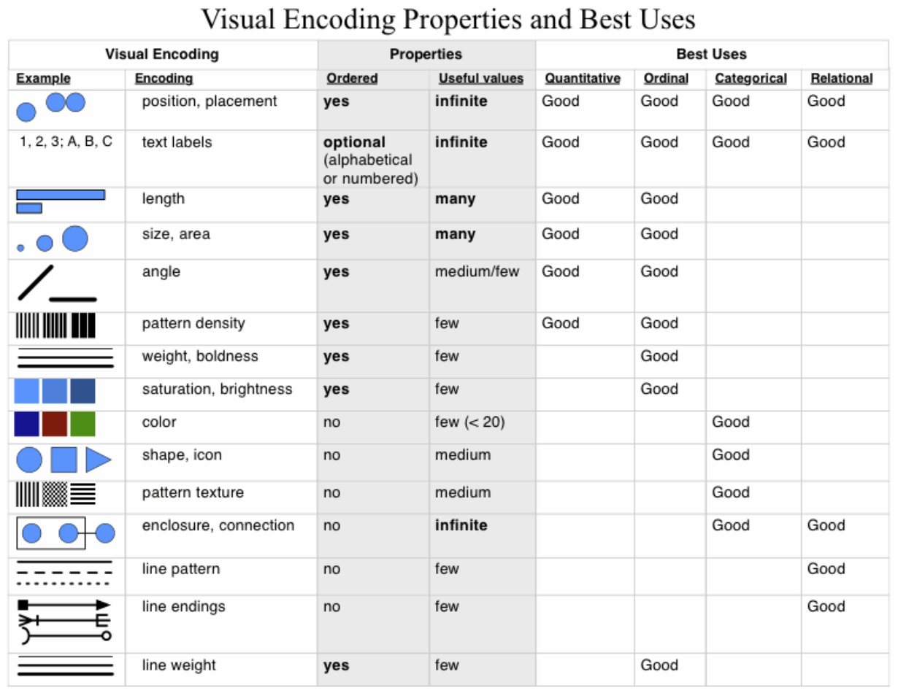
Visualization Design “Materials”
Noah Iliinsky (UX Designer at Amazon) created this useful illustration:

Slide 10
Visualization Design
I found this list from A Primer of Visual Literacy by Donis Dondis to be a great design checklist to apply to visualizations:
Simplicity
Symmetry
Angularity
Abstraction
Consistency
Unity
Organization
Economy
Subtlety
Continuity
Regularity
Sharpness
Monochromaticity
While I’m not saying you should literally try to check everything off here, the more items your visualization meets on the above checklist, the better it will probably be.

Slide 11
UI, UX, and Visualization

Slide 12
UI/UX Job Growth and Breadth
UI/UX job titles & responsibilities:
Interaction Designer
Visual Designer
UX Designer
Information Architect
Usability Analyst
User Researcher

Slide 13
Visualization and UI/UX
A look at the overlap of data visualization strategies and job titles & responsibilities in UI/UX
Understanding your user’s needs and requirements User Researcher
Organized, easy to navigate Information Architect
Well designed UX Designer
Relevant content
Appropriate structure
Useful formatting
Measuring the effectiveness of a visualization Usability Analyst
Looks good Visual Designer
Nice colors
Simple, clean
Graphic design
Ability to filter, sort, drill-down Interaction Designer

Slide 14
Other UI/UX tasks that map nicely to data visualization
Mocking wireframes – Instead of building a final visualization, sketch out rough ideas on a whiteboard or in an application. (Check out Balsamiq, of you’re looking to try something out.)
Creating prototypes – If building an interface (rather than a static report), create mostly functional tools that help you…
Testing and refining – Computers offer the ability to test and refine various approaches to data visualization.

Slide 15
Bad UX
While many bad visualization examples are centered on complexity, messiness, and graphic overload, bad UX examples, highlight more simple and sometimes insidious issues

Slide 16
Bad UX
Visualization improvement strategies :
Make sure labels are in the right place.
Pay attention to the usage and meaning of symbols.
Use vertical space intuitively. (Up means up or +, down means down or -)

Slide 17
Bad UX
Visualization improvement strategies:
Don’t confuse symbols and labels (message).
Keep things consistent.

Slide 18
Bad UX
Visualization improvement strategies:
Reduce complexity
Make things discoverable, and intuitive where possible
Have a clear plan from the beginning
Don’t keep adding elements or features simply because you can

Slide 19
Bad UX
Visualization applications:
When using colors, use them in an intuitive manner, if possible.
Be aware of color connotations in different cultures.

Slide 20
Visualization Delivery

Slide 21
How are visualizations presented?
Print (WSJ stock chart)
Static digital (538 Chart)
Interactive digital (NYTimes)
Mobile (Fitbit)
Desktop Application (Excel, Tableau)
Enterprise Tool (Oracle)

Slide 22
Print
Highly static, less sharable.
Can compliment a digital presentation. Something to take home
Generally less and less common.
Edward Tufte focuses a great deal on print.
Pay attention to:
Colors: can be different in print vs digital
Scale: What will be the scale of the final product, graphics, visuals
Resolution: Generally much more than computer screens, although that’s changing.
People may spend more time with it than digital

Slide 23
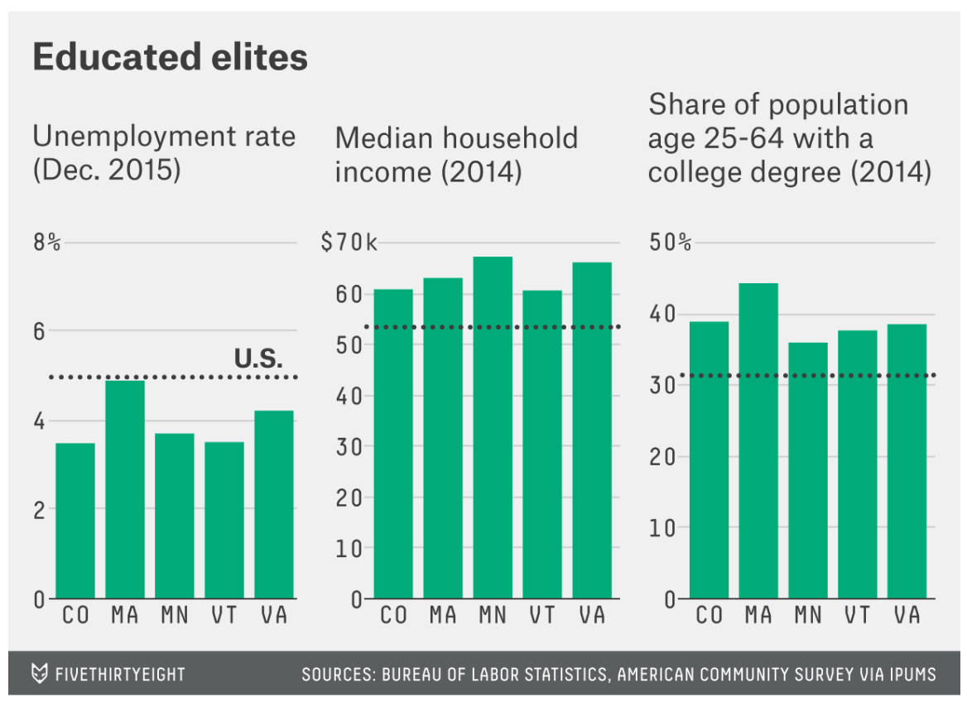
Static digital
Very common delivery method.
Can focus the user.
Less prone to software “bugs”.
Better for telling stories.
Pay attention to:
What will be the key takeaway or takeaways?
Keep it simple, clean
Get everything right: title, labels, axes, units
Short attention span: Usually viewers might take just a few seconds
Will it be printed out? If so, you should print it first

Slide 24
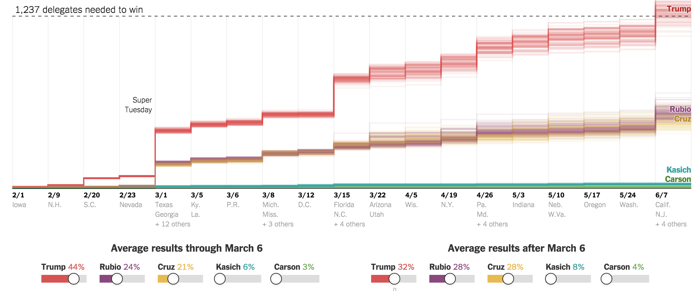
Interactive digital
Highly sharable (or at least they probably should be)
Can be static or interactive
Usually require custom software code
Pay attention to:
Sharability
Ease of use and interaction patterns.
Does it work in all browsers?
If it’s an unfamiliar interface, help the viewers learn.
Will it (and can it) be viewed on mobile?

Slide 25
Mobile
The highest growth delivery platform today
Tough to create your own app business, but many businesses have whole teams dedicated to building mobile apps
Pay attention to:
Screen size
Interactivity – generally, keep it to a minimum
Simplicity is critical
Wide variety of mobile devices and platforms
Double clicking, and hovering are less likely

Slide 26
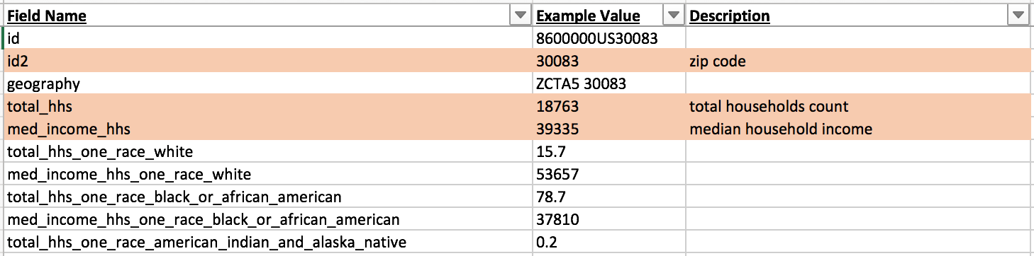
Desktop Application
Due to the ease of going from data to visualization, this is the most familiar method of visualization delivery
Each tool has strengths and weaknesses.
Pay attention to:
Versions – Operating systems and software versions change a lot over time
Users can really drill in to your data, and may go somewhere you don’t expect
If possible, constrain the solution to a static or limited interaction, especially as audience is more high-level

Slide 27
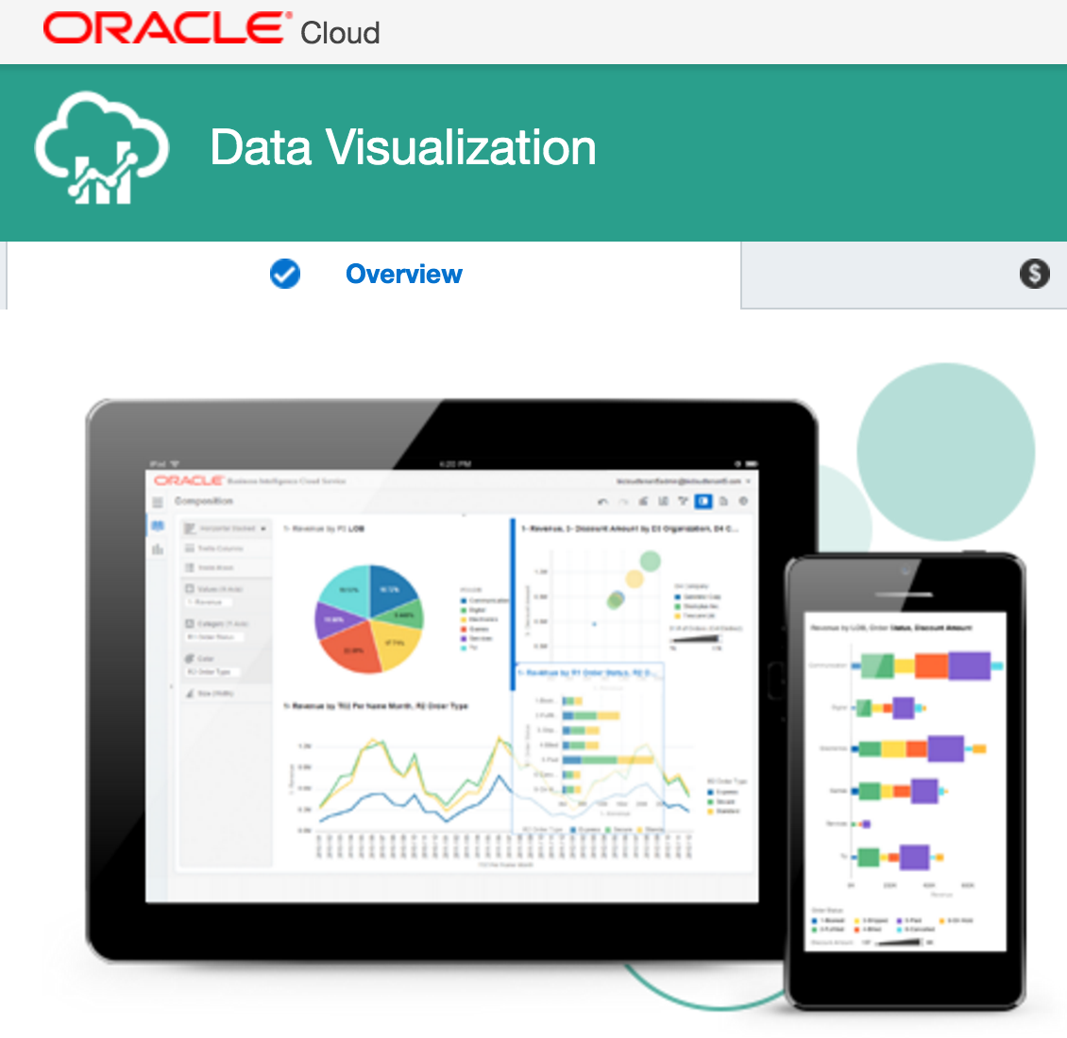
Enterprise Tools
Many enterprise tools offer visualization components.
There will continue to be investment and growth in enterprise visualization
Pay attention to:
Get training from your employer or enterprise to full leverage the solution
Make sure your viewers have access to the tool, or that you can deliver a proper visualization

Slide 28
How are visualizations presented?
Each method of visualization delivery is a steep learning curve for both creator and sometimes consumer.
Think about what makes you most productive and is wanted or needed by your visualization consumers.

